Slide 1



National Technical Honor Society
Your CTE Honor Society

Slide 2
What is NTHS?
We believe in advocating for all skilled career paths and empowering students in seeking skill to build their career and the global workforce.
NTHS honors the achievements of top CTE students, provides close to $300,000 in scholarships annually, and strives to help connect education and industry to build a highly skilled workforce.
We achieve this through the implementation of career development, leadership, service and recognition opportunities -The NTHS Core Four Objectives.

Slide 3

Core Four Objectives
By participating in NTHS, you will utilize the NTHS Core Four Objectives to grow and prepare for your continued education and career.
Career Development
  Resumé development workshops, mock interviews, career fairs, industry speakers, and credential opportunities
Leadership
  Team-building activities, leader training & workshops
Service
  Skill-based service projects, community needs-based projects, annual holiday service projects
Recognition
  Design & distribute nomination letters and induction invitations, assist in coordinating the Induction Ceremonies

Slide 4


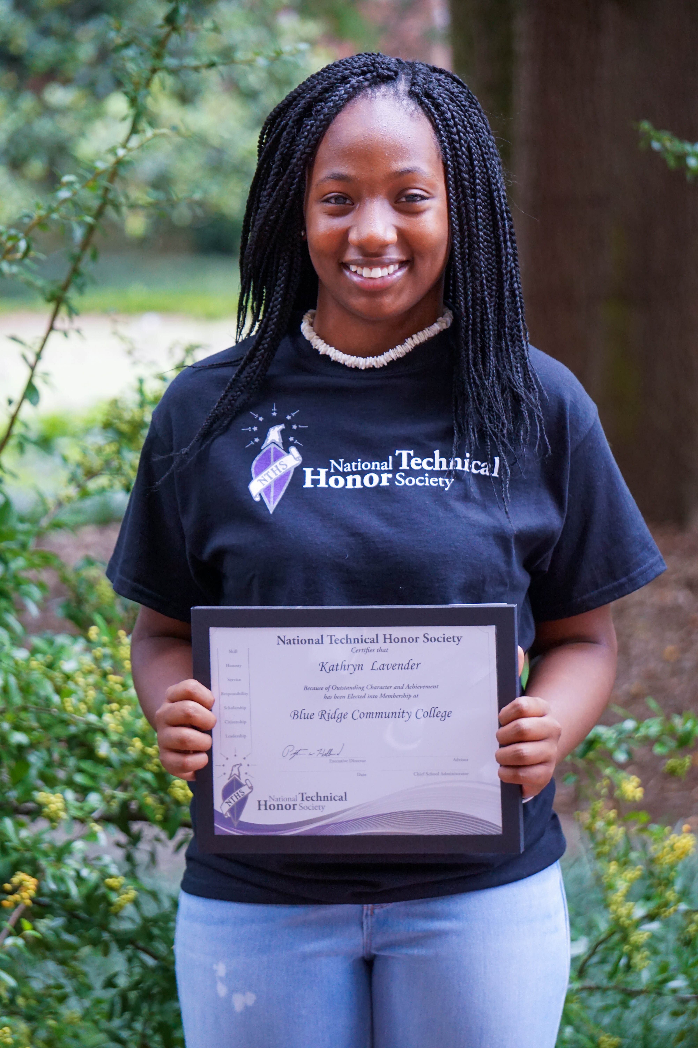
Member Benefits
Scholarships
Nearly $300,000 in scholarships are awarded annually to NTHS members. Some of our scholarship partners are:
Letters of Recommendation
Letters of recommendation for employment, admission, and scholarships.
Membership Kit
Includes your membership certificate, NTHS pin, tassel, decal, graduation seal, and portfolio!
Partner Discounts
Lenovo
OfficeMax/Office Depot
CareerSafe
MajorClarity

Slide 5

Partner Programs
Career Readiness Portal
The NTHS Career Readiness Portal is an outstanding member benefit add-on that will help students prepare for their career and continued education. Powered by MajorClarity, a company leading the way in cutting edge career exploration solutions, this tool provides students access to a variety of career readiness resources that have helped hundreds of thousands of students prepare for their next step.
LAPSEN Endorsement
LAPSEN is the premiere support organization for the Law, Public Safety, Corrections and Security Career Cluster (LPSCS) in secondary education. With the opportunity to qualify for the LAPSEN endorsement on their NTHS membership, students in a Law, Public Safety, Corrections and Security (LPSCS) Career Cluster pathway are now getting industry specific recognition for their performance in that field.
LAPSEN

Slide 6


Partner Programs
CareerSafe 10-Hour OSHA Safety Training Online Course
CareerSafe OSHA 10-Hour training is a comprehensive program covering foundational safety and health topics like hazard recognition, personal protective equipment, and safety management. These courses are essential for individuals entering the workforce, providing them with the necessary safety knowledge to help prevent workplace accidents and injuries.
For a special discounted rate, advisors can add the CareerSafe OSHA 10-Hour course access for their members, or individual student members can purchase their own course access. This offer is only available for secondary-level and duel-enrolled students.

Slide 7
Details for
Chapter Name Here

Slide 8
Criteria for Membership
See Criteria for Membership in the Advisor Guidebook
INSERT CHAPTER SPECIFIC REQUIREMENTS

Slide 9
Dues and Deadlines
INSERT CHAPTER SPECIFIC DUES
INSERT DEADLINE TO PAY DUES

Slide 10
Induction
The (INSERT SCHOOL NAME) NTHS Fall/Spring Induction will take place on:
DATE and TIME
LOCATION

Slide 11




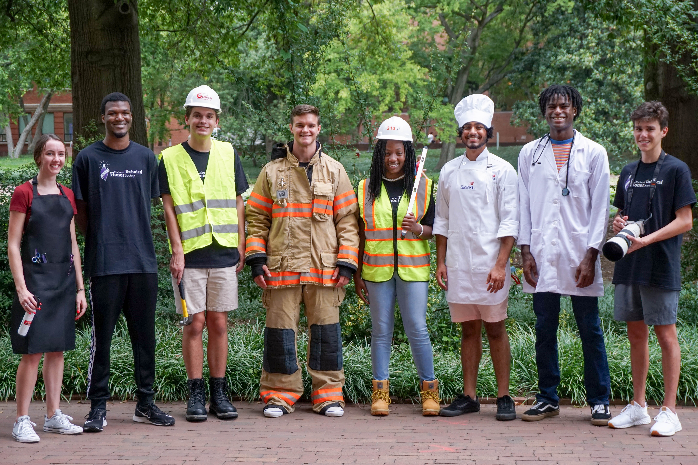
From the classroom to career

Slide 12


Slide 13


