Slide 1



(Insert School Name Here)
20XX Induction Ceremony

Slide 2

Welcome
First Name
Last Name
Title
Organization

Slide 3
Purposes

Slide 4
To reward excellence in
workforce education.

Slide 5

To develop self-esteem, pride and encourage students to reach for higher levels of achievement.

Slide 6
To promote business and industry’s critical workplace values – honesty, responsibility, initiative, teamwork, productivity, leadership, and citizenship.

Slide 7
To help schools build and maintain effective partnerships with local business and industry.

Slide 8
To champion a stronger, more positive image for workforce education in America.

Slide 9
Colors

Slide 10
Value & Worth
Truth & Honesty
Achievement & Honor

Slide 11
Emblem

Slide 12
stars
eagle
shield
plumb line
scroll

Slide 13
Motto
Success Favors the Prepared Mind.

Slide 14
Slogan
Excellence in America’s Workforce Begins with Excellence in Workforce Education.

Slide 15
Installation of Officers

Slide 16
President
First Name
Last Name
CTE Area of Study
Class

Slide 17
Vice President
First Name
Last Name
CTE Area of Study
Class

Slide 18
Secretary
First Name
Last Name
CTE Area of Study
Class

Slide 19
Treasurer
First Name
Last Name
CTE Area of Study
Class

Slide 20

Candle Ceremony

Slide 21
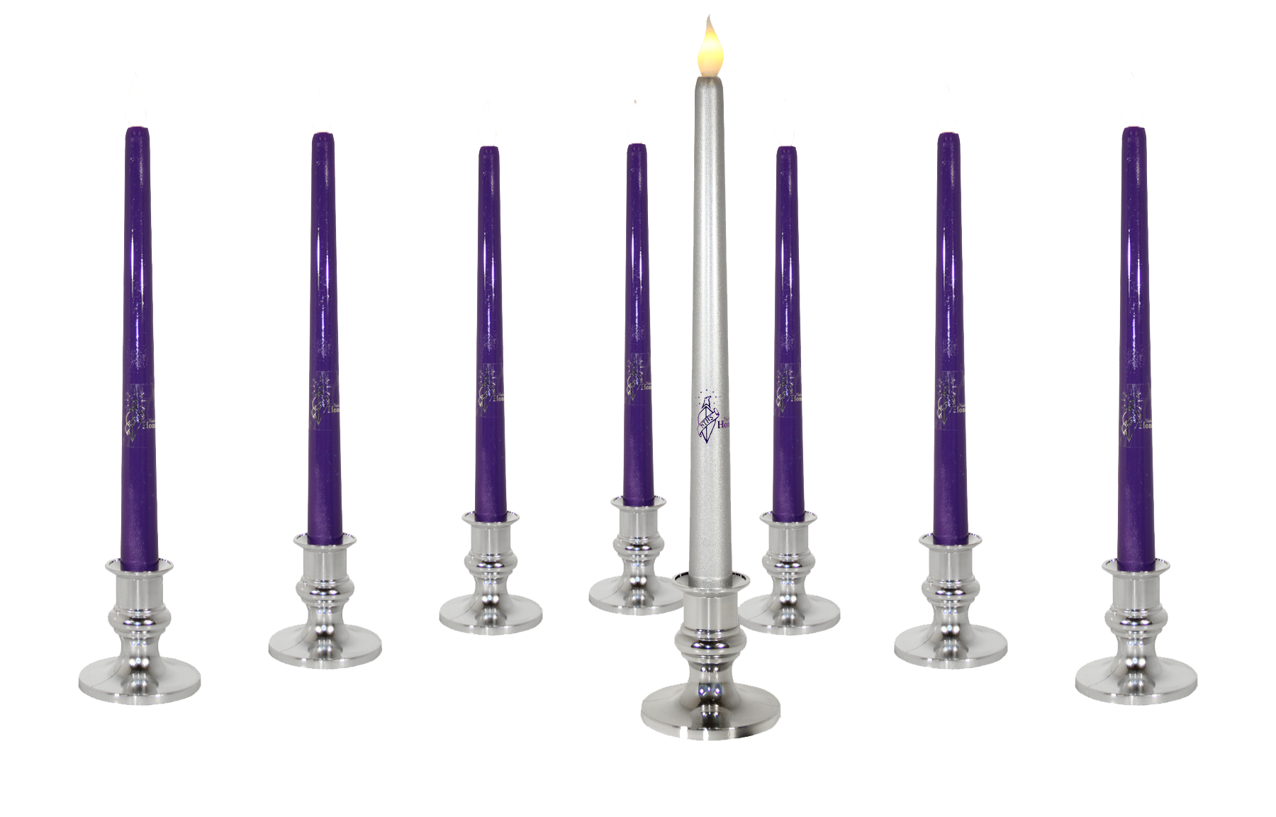
KNOWLEDGE

Slide 22

SKILL

Slide 23

HONESTY

Slide 24

SERVICE

Slide 25

RESPONSIBILITY

Slide 26

SCHOLARSHIP

Slide 27

CITIZENSHIP

Slide 28

LEADERSHIP

Slide 29
Guest Speaker
First Name
Last Name
Title
Organization

Slide 30
Induction Ceremony

Slide 31
Instructions: Copy and past the following slide for as many students as you have before dropping a photo in. That will allow you to easily drop each student’s photo in their own frame.
First Name
Last Name
CTE Area of Study
Class

Slide 32
First Name
Last Name
CTE Area of Study
Class

Slide 33
Pledge

Slide 34
As a member of the National Technical Honor Society, I pledge to maintain the highest standard of personal conduct.
I will apply myself to continue a record of scholastic achievement, and I will strive for excellence in all aspects of my education.
I will invest my talents, my skills, and my knowledge in a career of my own choosing, and shall always endeavor to uphold my obligations as a citizen of my community and my country.

Slide 35
Closing
First Name
Last Name
Title
Organization

Slide 36
Welcome New Members!

Slide 37

All new members are eligible to enter a monthly $25 Amazon gift card drawing.
Scan the QR Code for details.

